Slide 1

ECE-2002 Computer Organization and Architecture
Dr. Kritika Bansal
School of Electronics Engineering, VIT-AP

Slide 2
Addressing modes
The addressing mode describes the types of operands and the way they are accessed for executing an instruction.
According to the flow of instruction execution, the instructions may be categorized as
1. Sequential control flow instructions
2. Control transfer instructions
Sequential control flow instructions are the instructions which after execution, transfer control to the next instruction appearing immediately after it (in the sequence) in the program. For example the arithmetic, logic, data transfer and processor control instructions are Sequential control flow instructions.
The control transfer instructions transfer control to some predefined address or the address somehow specified in the instruction

Slide 3
Addressing modes for Sequential control flow instructions
Register addressing mode
Immediate addressing mode
Direct addressing mode
Register indirect addressing mode
Indexed addressing mode
Based indexed addressing mode
Register relative addressing mode
Relative based indexed addressing mode

Slide 4
Register addressing mode
In this mode, both the operands are specified by registers.
Eg. MOV AX, BX
All the registers can be used in this mode.
Both the source and destination registers should be of the same size

Slide 5
Immediate addressing mode
In this mode, the source operand is specified as immediate data byte or word and the destination is either a register or a memory location.
Eg. MOV AL, 22H; MOV BX, 3456H
All the registers can be used in this mode.
Both the source and destination registers should be of the same size

Slide 6
Direct addressing mode
In this mode, the source is a memory location and the destination is a register.
Eg. MOV AL, [1234H]
Here, a 16-bit memory address is directly specified in the instruction as a part of it.

Slide 7
Register in-Direct addressing mode
Register indirect addressing mode allows data to be addressed at any memory location using the offset registers: BP, BX, DI or SI
In this mode, the effective address of the memory may be taken directly from one of the base register or index register specified by instruction
Eg. MOV AX, [BX]

Slide 8
Indexed addressing mode
In this mode, the offset address of the operand is stored in one of the index registers like SI or DI.
ES and DS are the default segments for DI or SI are used.
Eg. MOV AX, [SI]
Effective address is 10H*DS+[SI]

Slide 9
Based-Indexed addressing mode
In this mode, one base register (BX or BP) and one index register (SI or DI) are used to indirectly address memory.
The effective address is formed by adding contents of a base register to the contents of the index register.
Eg. MOV AX, [BX] [SI]
Effective address is 10H*DS +[BX]+[SI]

Slide 10
Register relative addressing mode
In this addressing mode, the data is available at an effective address formed by adding an 8 bit or 16 bit displacement with the content of any one of the offset registers BX, BP, SI and DI in the default (either DS or ES) segment.
Eg. MOV AX, 1000H [BX]
Effective address is 10H*DS+1000H+[BX]

Slide 11
Relative Based-Indexed addressing mode
It is similar to the based indexed mode, but it adds a displacement along with the base register and index register to form the memory address
The effective address is formed by adding the 8-bit or 16-bit displacement with the addition result of the base register and the index register.
Eg. MOV AX, 2000H [BX] [SI]
Effective address is 10H* DS+[BX]+[SI]+2000H

Slide 12
Addressing modes for Sequential control flow instructions
Register addressing mode (MOV AX, BX)
Immediate addressing mode (MOV AL, 22H)
Direct addressing mode (MOV AL, [1234H])
Register indirect addressing mode (MOV AX, [BX])
Indexed addressing mode (MOV AX, [SI])
Based indexed addressing mode (MOV AX, [BX] [SI])
Register relative addressing mode (MOV AX, 1000H [BX])
Relative based indexed addressing mode (MOV AX, 2000H [BX] [SI])

Slide 13
Addressing modes for Control transfer instructions
Intrasegment direct addressing mode
Intrasegment indirect addressing mode
Intersegment direct addressing mode
Intersegment indirect addressing mode
If the destination lies in the same segment, the mode is called intrasegment mode
If the address location to which the control is to be transferred lies in a different segment other than the current one, the mode is called intersegment mode.

Slide 14
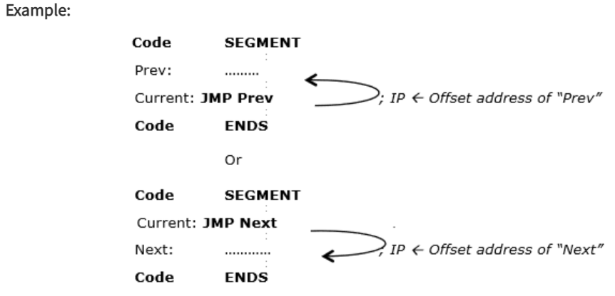
Intrasegment Direct mode
In this mode, the effective branch address to which the control is to be transferred lies in the same segment in which the control transfer instruction lies and it appears directly in the instruction as an immediate displacement value.

Slide 15
Intrasegment Indirect mode
In this instruction, the control is jumped to an address specified by the 16-bit register or a memory location.
Eg. JMP [BX]; Jump to effective address stored in BX

Slide 16
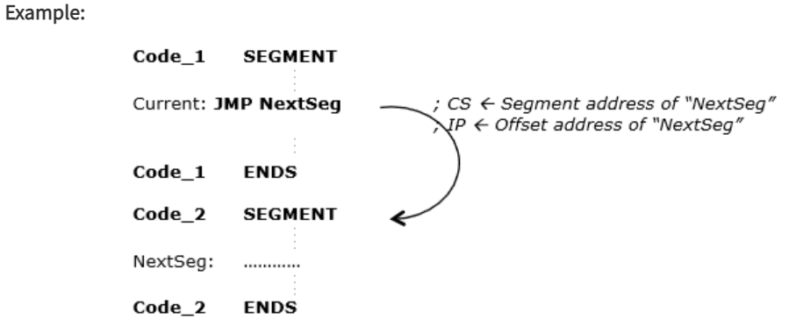
Intersegment Direct mode
This addressing mode is used to provide means of branching from one segment to another segment.

Slide 17
Intersegment Indirect mode
In this mode, the address to which the control is to be transferred lies in a different segment and it is passed to the instruction indirectly
Example: JMP [2000H]; Jump to an address in the other segment specified at effective address 2000H in DS.

